Slide 1


Infosys Springboard
LOGISTIQ
AI Driven Supply Chain Disruption Predictor and Inventory Optimization System
BY SONIA KOLAY
(You’re personal warehouse manager)
LogistiQ-Github

Slide 2


Introduction to
the Project
Planning
What is a Supply Chain?
A supply chain refers to the network of activities involved in producing and delivering a product or service to customers.
It includes sourcing raw materials, manufacturing, logistics, inventory management, and distribution.
The goal is to ensure smooth operations, minimize costs, and deliver products efficiently to customers.
Sourcing
Customer Service
Production
Inventory Management
Logistics

Slide 3
Problem Statement
Background:
Global supply chains face significant challenges, including disruptions caused by geopolitical events, natural disasters, and transportation inefficiencies. These disruptions result in overstocking, understocking, delayed responses, and increased costs, affecting business continuity and profitability.
Backlogs in Risk Prediction:
Traditional methods lack predictive capabilities, often resulting in unanticipated supply chain disruptions.
Inventory Management Inefficiencies:
Manual and rule-based inventory systems struggle with demand forecasting and stock optimization.
Objectives:
Predict Supply Chain Disruptions: Utilize AI/ML models to forecast disruptions using data from news, supplier updates, and transportation trends.
Optimize Inventory Levels: Provide data-driven inventory adjustment recommendations to minimize overstocking and understocking.
Enable Real-Time Alerts: Deliver instant notifications and insights through Slack or email for proactive decision-making.
Integrate Seamlessly: Connect with ERP systems to automate reordering and stock adjustments.

Slide 4
Features
Risk Prediction:
Importance: Helps identify supply chain disruptions before they occur.
Achievement: Implemented using ML models like Random Forest for risk classification.
Inventory Optimization:
Importance: Reduces overstocking and understocking, improving operational efficiency.
Achievement: Linear programming techniques integrated with demand forecasting models.
Dashboard for Visualization:
Importance: Provides real-time insights into inventory and risk factors.
Achievement: Built using Streamlit, with PostgreSQL as the backend for data storage.
Category-Specific Customization:
Importance: Tailors solutions for unique categories like groceries and perfumes.
Achievement: Data segmentation and unique risk models for each category.

Slide 5


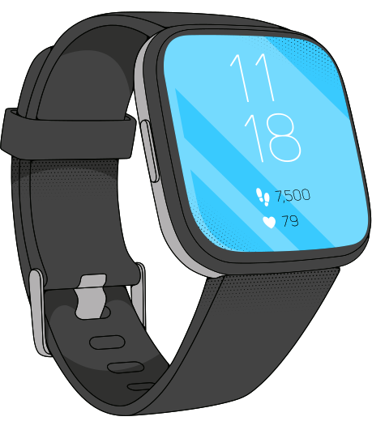



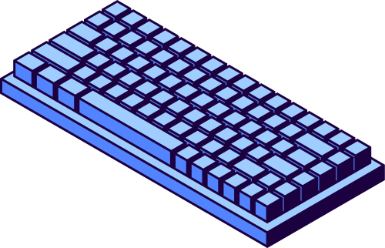
Product: Electronics
Purpose:
To optimize the supply chain for electronics, a high-demand and time-sensitive product category, ensuring timely delivery, reduced costs, and minimized risks caused by disruptions such as raw material shortages, geopolitical issues, or transportation delays.
Use-Case:
The system predicts supply chain disruptions for electronics, adjusts inventory levels dynamically, and ensures timely restocking. It handles complex challenges like sourcing semiconductor chips, managing multi-tier suppliers, and addressing global shipping bottlenecks.

Slide 6
Methodology
and Approach
Start
Data Collection
Data Preprocessing(Handling and Cleaning Missing datavalues)
Model Training (XGBoost Model)
Integrated into an ERP System
Trained over preprocessed data
Global Supply Chain Disruption Data (using News API)
Product Data (Electronics)
Slack Alert Notification System
If accuracy == 1
Real-Time Alert Integration
Local Storage
LogistiQ Dashboard
Yes
No
The above architecture diagram illustrates the methodology and approach for the supply chain project. It begins with data collection from sources like global disruption data (via News API) and product data, stored locally. The data undergoes preprocessing (handling missing values) and is fed into the XGBoost model for training, iterating until accuracy is achieved. The trained model integrates into an ERP system with real-time alert notifications (via Slack) and powers the LogistiQ Dashboard for actionable insights.

Slide 7
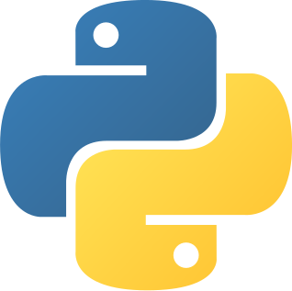

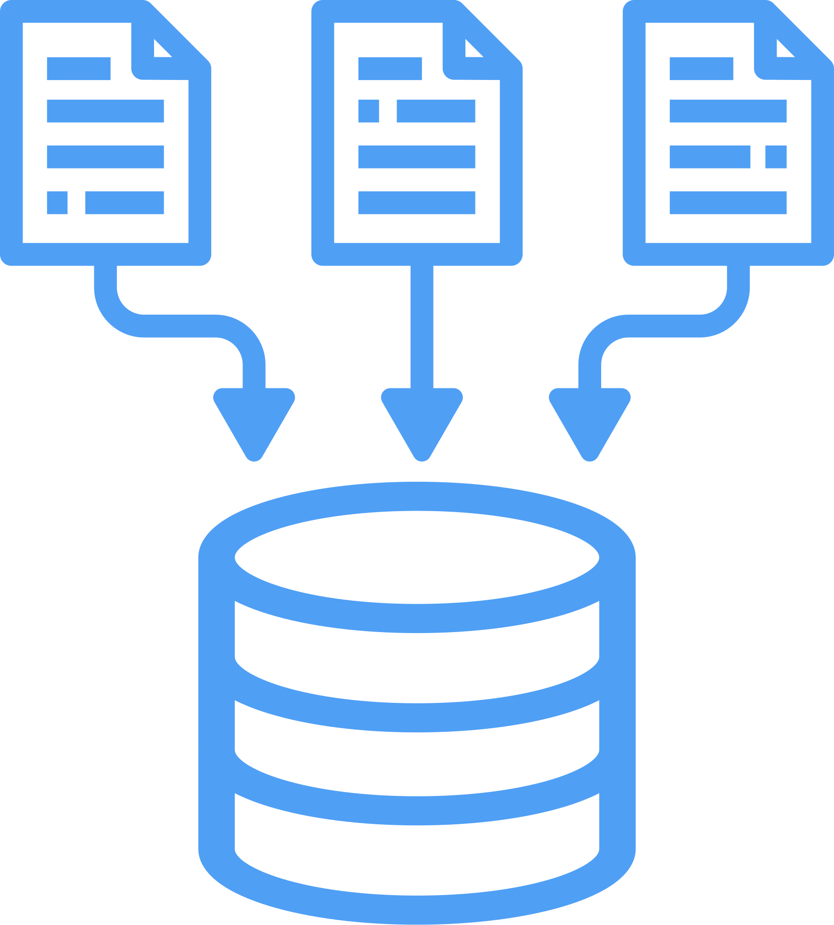
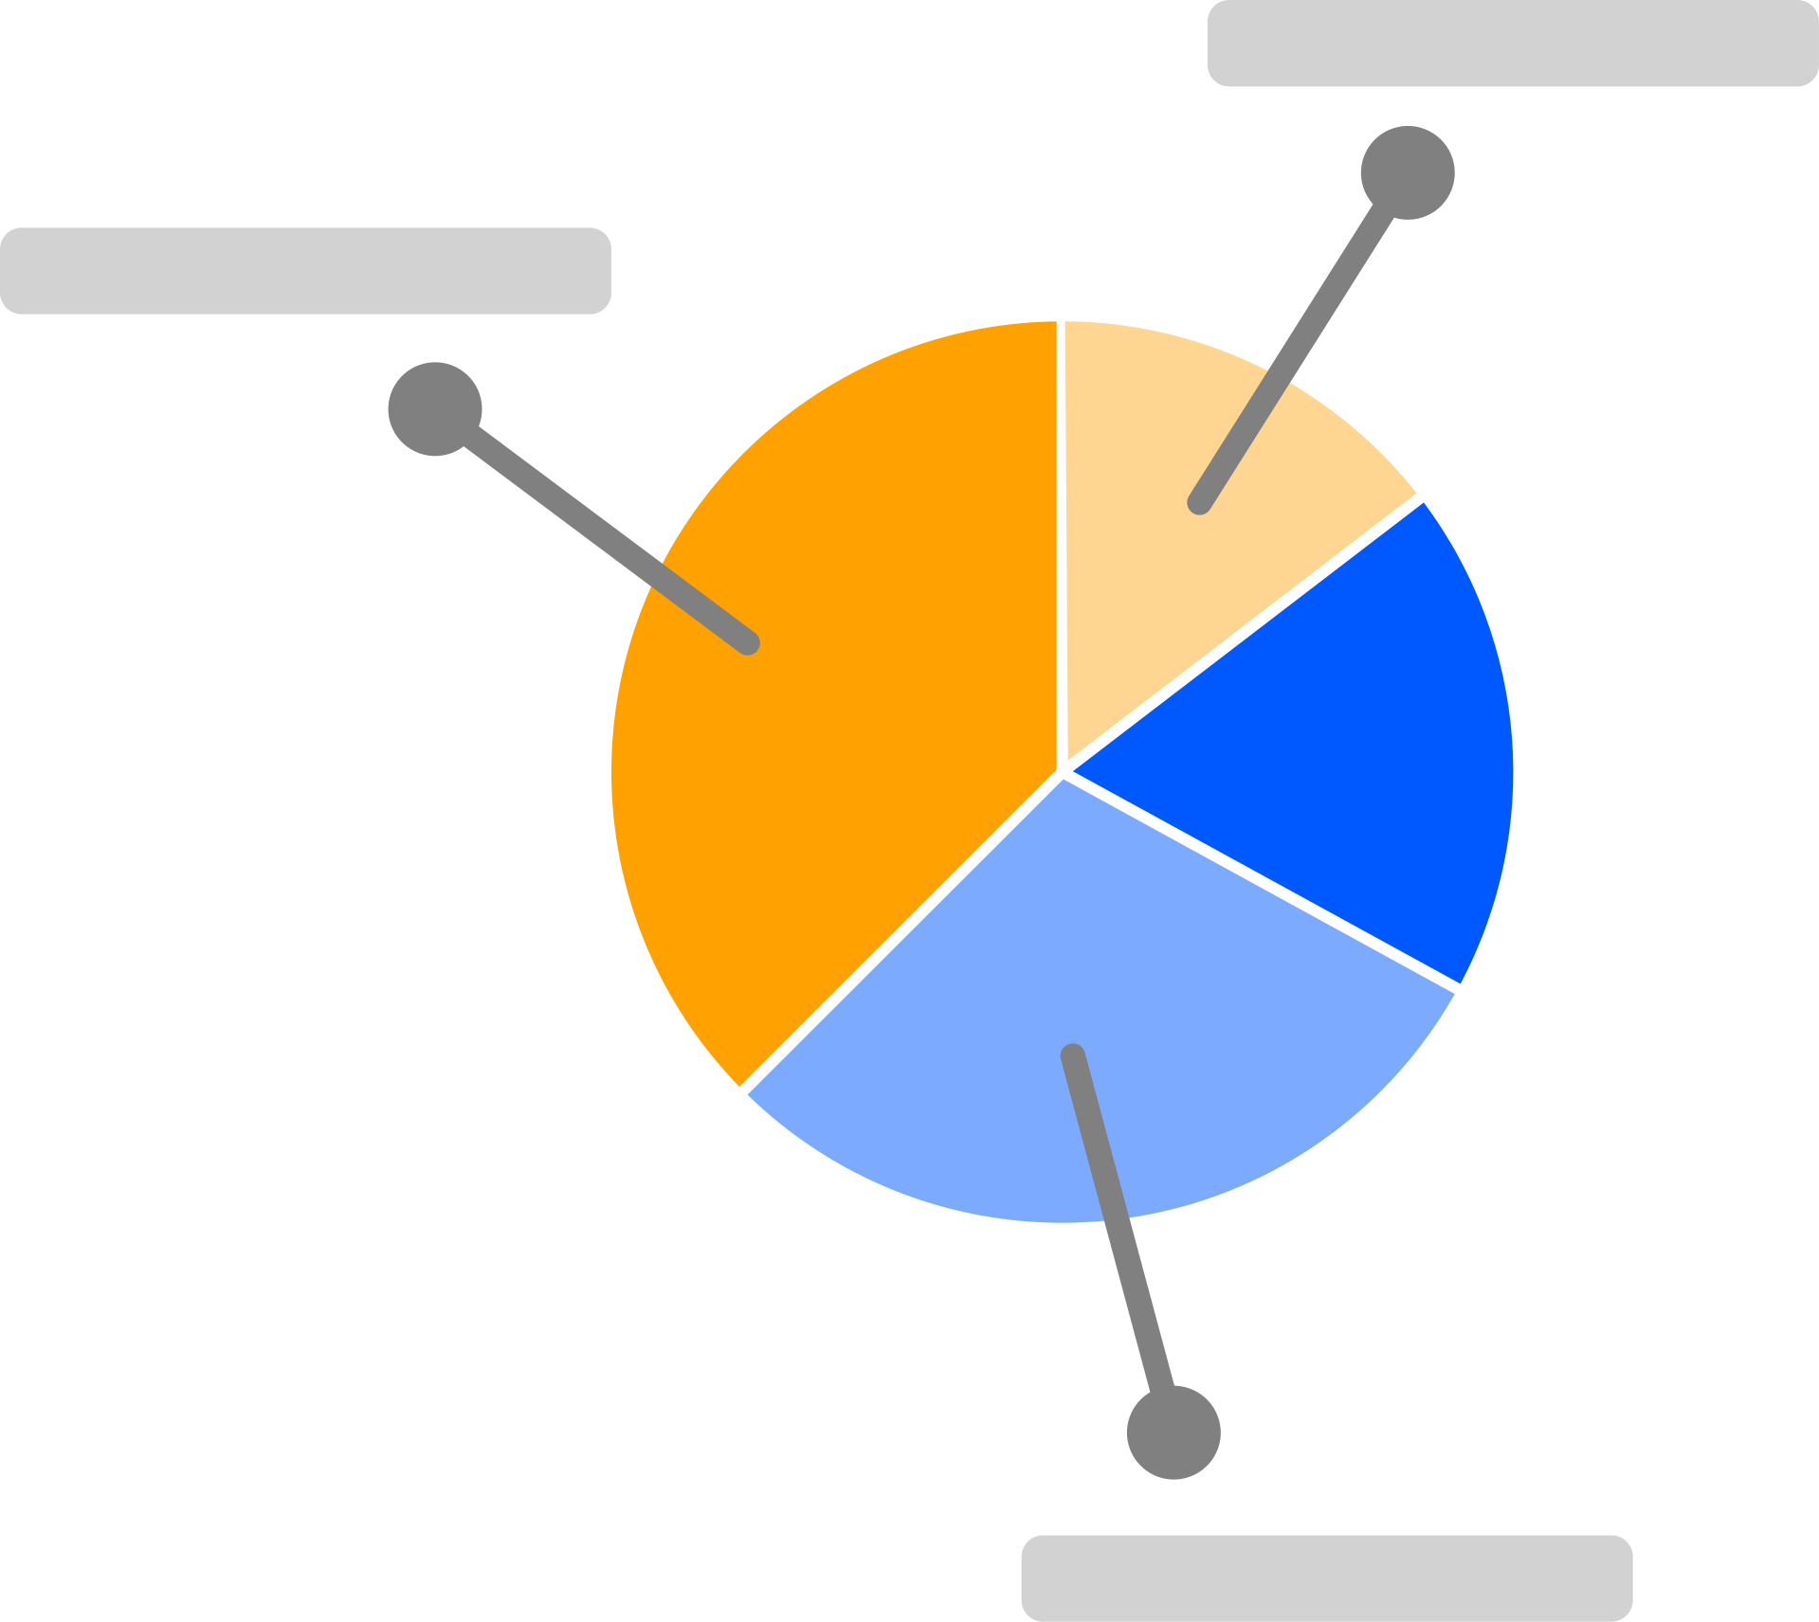
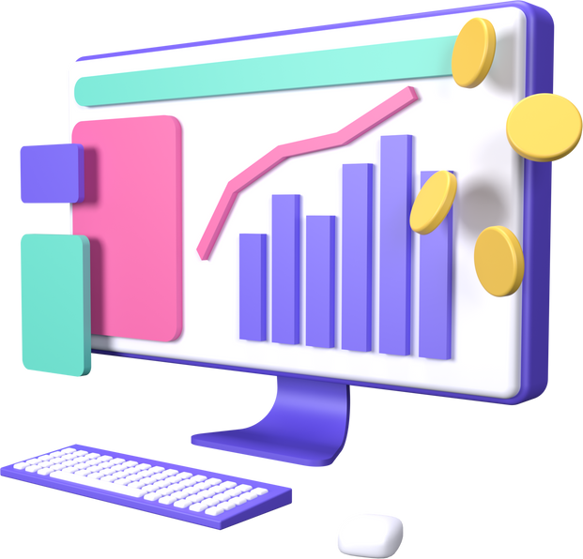
Technology Stack
Python: Core programming language for ML models and backend scripting.
Scikit-Learn: For building machine learning models like risk prediction and demand forecasting.
PostgreSQL: Relational database for storing supply chain and inventory data.
Matplotlib & Seaborn: Visualization libraries to display trends and risks in the dashboard.
Streamlit: Used to build an interactive and dynamic web-based dashboard.

Slide 8
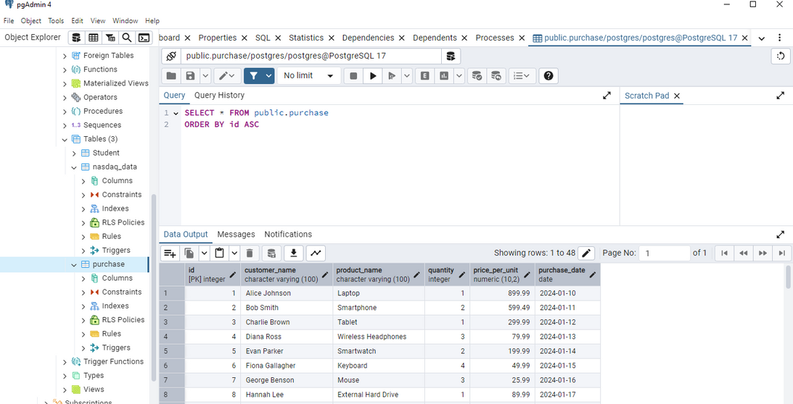
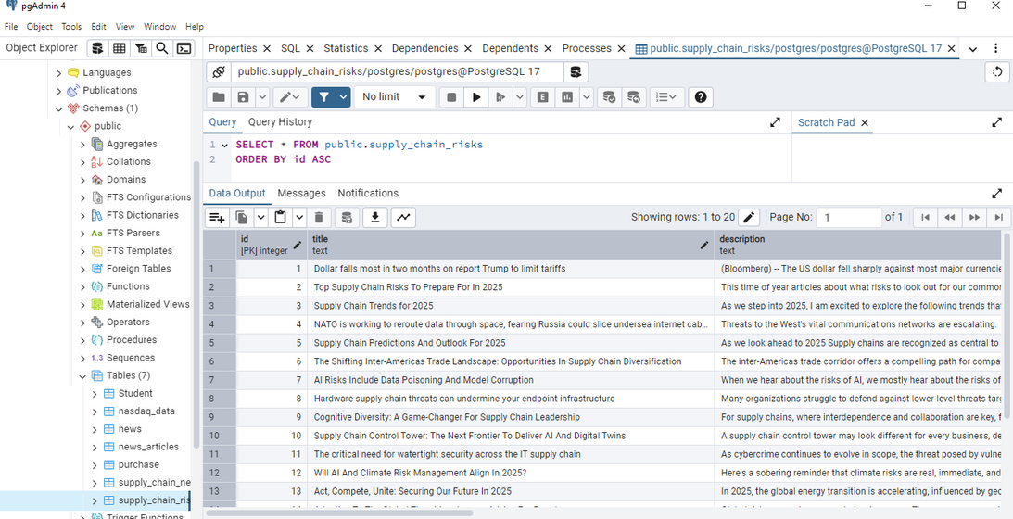
Milestone 1: Global Data Monitoring & Analysis engine
Supply Chain Disruption & Risk Data
Product Data
Made use of NLP to analyze news, supplier data and transportation updates while identifying risks and trends in the supply chain by using API calls and readily available datasets.

Slide 9
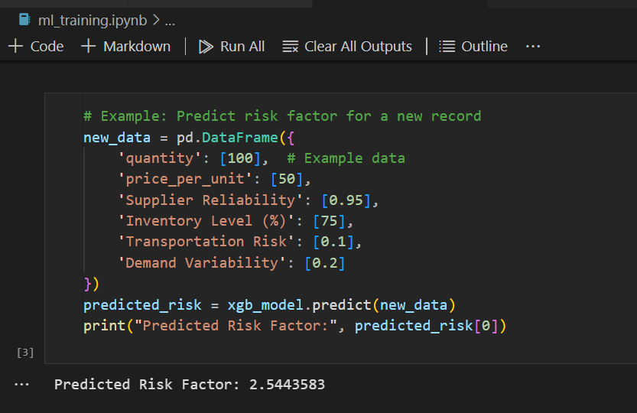
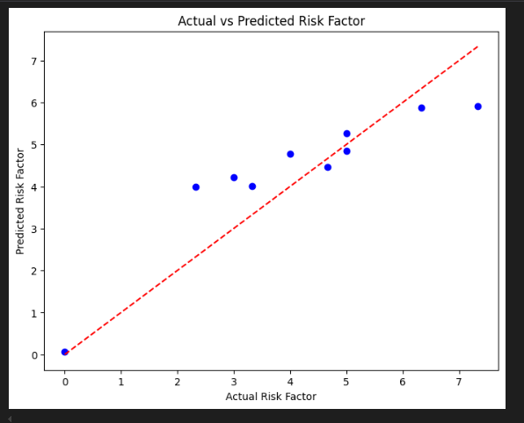
Milestone 2: Predictive Disruption Modelng System
Employed machine learning algorithms to forecast potential disruptions
and their impact on supply levels. Generated risk scores and probability assessments for various
disruption scenarios.

Slide 10
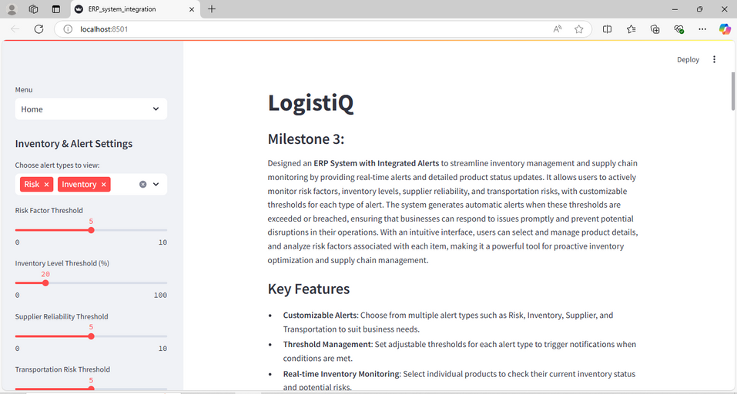
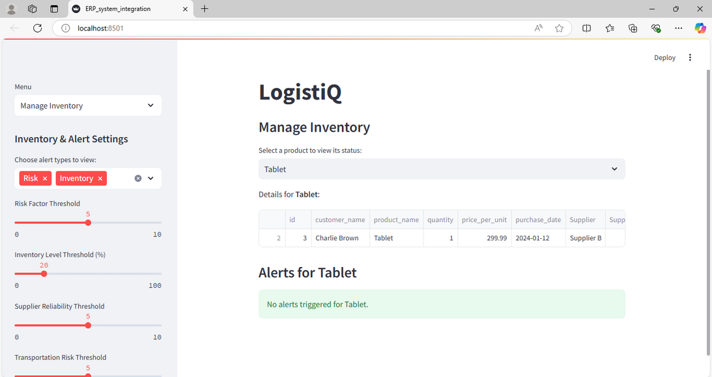
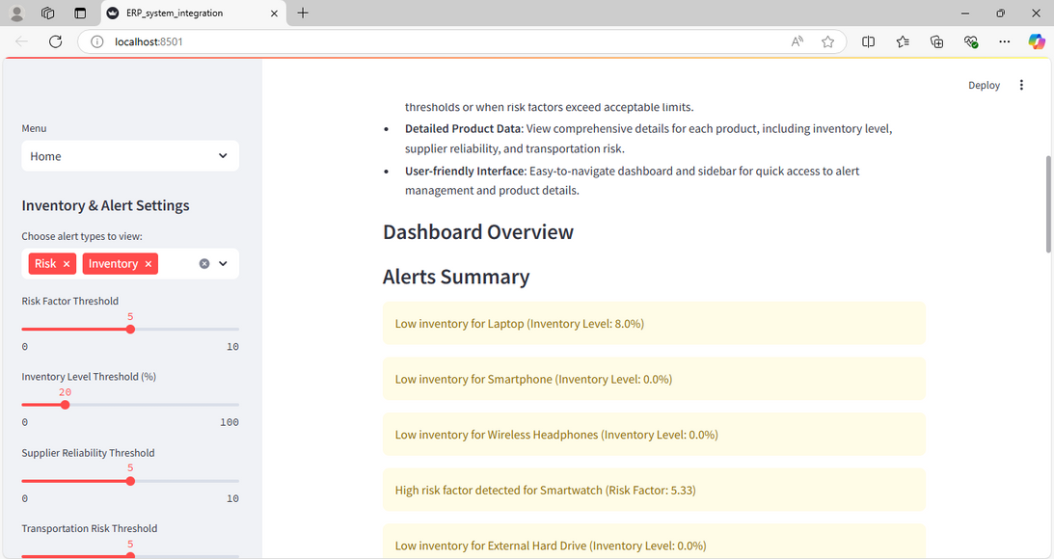
Milestone 3: ERP Integration & Inventory Adjustment Module
Seamlessly integratesd with a personally designed ERP system to recommend stock
adjustments and reorder points. which in turn provided automated, data-driven inventory optimization suggestions.

Slide 11
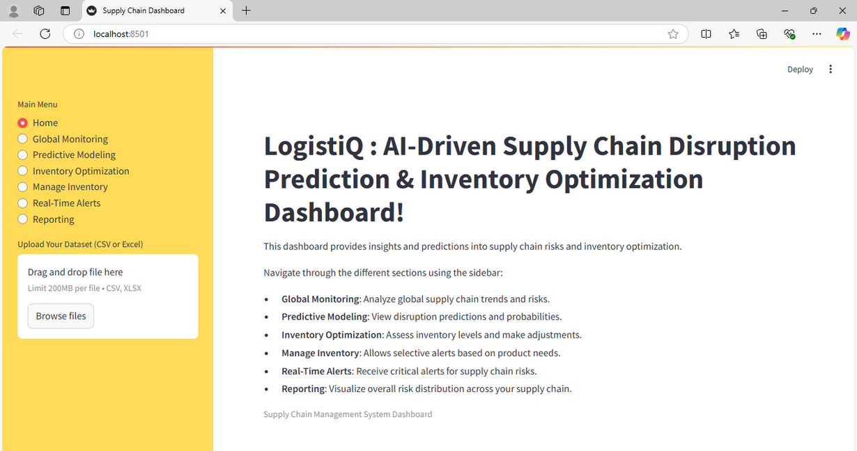
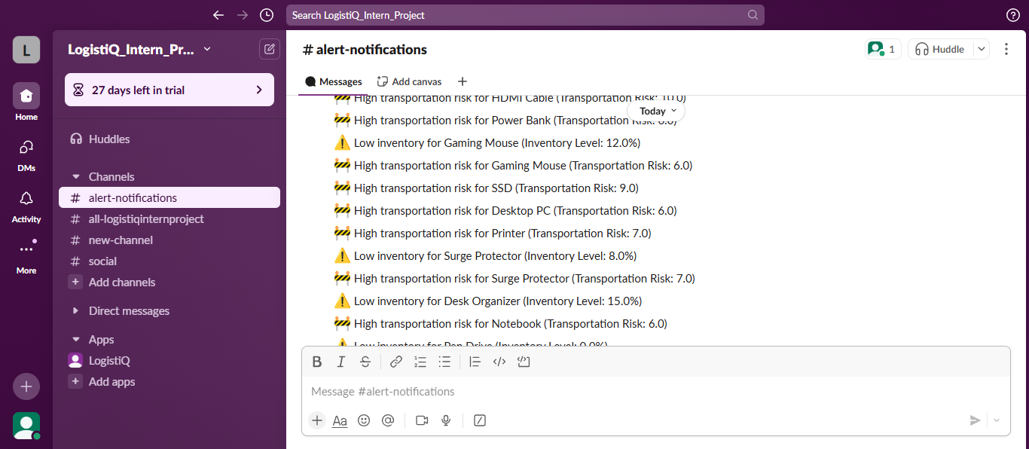
Milestone 4: Real-Time Alert & Reporting Dashboard
Delivers instant notifications via Slack for critical disruption
predictions and inventory recommendations, offering comprehensive visualizations of supply chain risks and inventory status.

Slide 12
Projected Outcomes
and Benefits
Enhanced Decision Making
Category-Specific Solutions
Risk Prediction
Centralized Data Management
Scalable Architecture
Real-Time Insights
Cost Efficient
AI/ML Integration
Customer Satisfaction
Future Ready
Data Driven Solutions
Notification Alert Integration

Slide 13
Challenges & Risks
Data Collection & Cleaning
Challenge: Data from sources like news APIs, supplier databases, and transportation logs may be incomplete, inconsistent, or outdated.
Solution: Implement robust data preprocessing techniques to clean and standardize data. Made useof real-time APIs and data validation techniques to ensure accuracy.
Real-time alert Delivery
Challenge: To ensure instant delivery of alerts without delays or failures in communication channels like Slack or email.
Solution:Made use of individual and personally set up channels to avoid delays in alert receptions.

Slide 14
Progress and
Future Scope
Incorporate Blockchain Technology for tracking and verifying the authenticity of products in the supply chain.
Use IoT Sensors to enable real-time tracking of inventory levels and conditions (e.g., temperature, humidity).
Expand the scope to include multi-modal transport optimization for cost savings.
Enhance user experience by adding voice-based or AI-powered chat support on the dashboard.

Slide 15
Conclusion
and Next Steps
The project demonstrates the power of AI and data-driven solutions in transforming supply chain management. By integrating advanced technologies like machine learning, real-time dashboards, and centralized databases, we’ve created a system that not only optimizes inventory and reduces risks but also enhances decision-making capabilities for businesses.
The modular and scalable architecture ensures adaptability to diverse categories, paving the way for broader applications in the future. With features like risk prediction, inventory optimization, and real-time insights, this project serves as a foundation for more innovative enhancements like IoT integration, blockchain for traceability, and predictive maintenance.
This journey highlights the importance of overcoming challenges in data management, model accuracy, and system integration, reflecting the potential of AI in reshaping the future of supply chain operations.
LogistiQ-Github

